Slide 1
Life to Eagle Seminar Golden Eagle District Greater Los Angeles Area Council
July 8, 2017
www.goldeneagledistrict.org

Slide 2
Golden Eagle District
Martín Cárdenas, District Chair
mcardenas@goldeneagledistrict.org
(909) 261-2840 cell
Huber Boñgolan, District Eagle Board Chair
hbongolan@goldeneagledistrict.org
(562) 307-0164 cell
Sal Rodriguez, District Advancement Chair
srodriguez@goldeneagledistrict.org
(626) 254-3650 cell
Gary Chow, District Finance Chair, Eagle Board Member

Slide 3
Agenda
Introductions
Review Requirements for Eagle Scout Rank
Discuss Eagle Scout Service Project
Review Eagle Application Process
Discuss Eagle Scout Binder
Discuss Eagle Board of Review
Eagle Candidate interview with the Eagle Board of Review
Discuss Eagle Coach, Unit Advisor or Mentor

Slide 4
Introductions
Tell us:
Your name.
Troop #.
Your position in your unit.
Why are you here?
We will take any specific questions at the end of the presentation.

Slide 5
Background
Boy Scouts of America (BSA) introduced several new changes and information:
Boy Scout Handbook, 13th Edition
Eagle Scout Project Workbook (2015)
Eagle Scout Rank Application #512-728
Guide to Advancement #33088 (2017)
Eagle Service Project Coach

Slide 6
BSA Guide to Advancement
The Guide to Advancement - 2017 Boy Scout Requirements are the official Boy Scouts of America sources on Boy Scout advancement procedures.
BSA Guide to Advancement #33088 (2017)
http://www.scouting.org/filestore/pdf/33088.pdf

Slide 7
Be Aware……
NO Council, District, Unit or Individual has the authority to
ADD to or SUBTRACT from any BSA advancement requirement
7

Slide 8
Background

Slide 9
Eagle Scout Rank Requirements

Slide 10
Eagle Scout Requirements
Active as Life Scout * 6 month minimum
Scout Spirit (Oath and Law) * and Duty to God.
Merit Badges * 21 minimum
Leadership Position * 6 month active
Eagle Scout Service Project *
Scoutmaster Conference *
Complete Eagle Board of Review
* All requirements, except Board of Review, must be completed before 18th birthday!

Slide 11
Eagle Requirements (cont.)
Be active in your troop, team, crew, or ship for a period of at least six months after you have achieved the rank of Life Scout.
BSA Guide to Advancement 2017 4.2.3.1 Active Participation
Three sequential tests used to determine where Active requirement has
been met. The first and second are required, along with the third or
its alternative.
Three tests
The Scout is registered.
The Scout is in good standing.
The Scout meets the unit’s reasonable expectations, or if not,
a lesser level of activity is explained.
It is appropriate for units to set reasonable expectations; or if not, a lesser level of activity is explained.

Slide 12
Test 1 – The Scouts is registered
The Scout is registered.
The youth is registered in his unit for at least the time period indicated in the requirement, and he has indicated in some way,
through word or action, that he considers himself a member.
If a boy was supposed to have been registered, but for whatever reason was not, discuss with the local council registrar the possibility of back-registering him.

Slide 13
Test 2 - The Scout is in good standing.
A Scout is considered in “good standing” with his unit as long as he has not been dismissed for disciplinary reasons.
He must also be in good standing with the local council and the Boy Scouts of America. (In the rare case he is not, communications will have been delivered.)

Slide 14
Test 3- The Scout meets the unit’s reasonable expectations, or if not, a lesser level of activity is explained.
If, for the time period required, a Scout or qualifying
meets those aspects of his Unit’s pre-established expectations that refer to a level of activity, then he is considered active and the
requirement is met.
Time counted as “active” need not be consecutive. A boy may piece together any times he has been active and still qualify. If he does not meet his unit’s reasonable expectations, then he
must be offered the alternative that follows.

Slide 15
Test 3- The Scout meets the unit’s reasonable expectations, or if not, a lesser level of activity is explained.
Alternative to the third test if expectations are not met:
If a young man has fallen below his unit’s activity oriented
expectations, then it must be due to other positive endeavors—in or out of Scouting—or due to noteworthy circumstances that have prevented a higher level of participation.

Slide 16
Eagle Requirements (cont.)
2. As a Life Scout, demonstrate Scout Spirit by living the Scout
Oath and Scout Law. Tell how you have done your duty to God,
how you have lived the Scout Oath and Scout Law in your
everyday life, and how your understanding of the Scout Oath
and Scout Law will guide your life in the future. List on your
Eagle Scout Rank Application the names of individuals who
know you personally and would be willing to provide a recommendation on your behalf, including parents/guardians,
religious (if not affiliated with an organized religion, then
the parent or guardian provides this reference), educational,
employer (if employed), and two other references
Evaluating Scout spirit will always be a judgment call, but through getting to know a young man and by asking probing questions…

Slide 17
Requirement 2 Scout Spirit continued
Demonstrate that you live by the principles of the Scout Oath and Law in your daily life.
This requirement is NOT for how you act in your Unit, but how you live your life!

Slide 18
Live by Oath & Law Continued……
This is NOT Troop Spirit
This is NOT wearing the uniform
This IS about abiding by the principles of the Scout Oath and Law in everything that you do.

Slide 19
Eagle Requirements (cont.)
Earn a total of 21 merit badges (10 more than you already have), including these 13 merit badges:
List of merit badges…
(a) First Aid, (b) Citizenship in the Community,
(c) Citizenship in the Nation, (d) Citizenship in the World,
(e) Communication, (f) Cooking, (g) Personal Fitness
(h) Emergency Preparedness OR Lifesaving,
Environmental Science OR Sustainability,
(j) Personal Management,
(k) Swimming OR Hiking OR Cycling,
(l) Camping, and (m) Family Life.
You must choose only one of the merit badges listed in categories h, i, and k.
Several merit badges require extended periods of time to complete!

Slide 20
Merit Badges and Scouts with Disabilities
There are special exceptions for Scouts with disabilities
Contact the District Eagle Board Chair or District Advancement Chair for guidance

Slide 21
Eagle Requirements (cont.)
While a Life Scout, serve actively for a period of 6 months in one or more of the following positions of responsibility:
List of positions…
While a Life Scout, serve actively in your troop for six months
in one or more of the following positions of responsibility:
Boy Scout Troop - Senior Patrol leader, Assistant Senior Patrol Leader, Patrol Leader, Troop Guide, Order of the Arrow Troop
Representative, Den Chief, Scribe, Librarian, Historian, Quartermaster, Junior Assistant Scoutmaster, Chaplain Aide, Instructor, Webmaster, or Outdoor Ethics Guide.
When a Scout assumes a position of responsibility, there is an expectation that something must happen.

Slide 22
Serve Actively in your Position of Responsibility
Time carried on the unit records in the position is all that is required.
You do not have to hold one position for six (6) months.
You do not have to hold the position for six (6)
consecutive months.
You may meet this requirement any time while a Life Scout.

Slide 23
Performance in the Position of Responsibility
A Scout may not be held to an extraordinary, undefined, or unknown standard of performance.
The standard of performance used to measure this requirement shall be the same as that applied to other Star, Life or Eagle Scout candidates.

Slide 24
Eagle Requirements (cont.)
While a Life Scout, plan, develop, and give leadership to others in a service project helpful to any religious institution, any school, or your community. (The project must benefit an organization other than Boy Scouting.) A project proposal must be approved by the organization benefiting from the effort, your unit leader and unit committee, and the council or district before you start. You must use the Eagle Scout Service Project Workbook, BSA publication No. 512-927, in meeting this requirement. (To learn more about the Eagle Scout service project, see the Guide to Advancement, topics 9.0.2.0 through 9.0.2.16.)
The key is to “plan, develop, and give leadership”…
(More on this later.)

Slide 25
Eagle Requirements (cont.)
Take part in a Scoutmaster conference.
A Scoutmaster conference is a positive experience, the objective of which is to help a Scout evaluate his accomplishments and set new goals. Even goals beyond the rank of Eagle and/or the age of 18.
Requirement does not say to “pass” a conference. It is also not required to be the last step before a Board of Review.

Slide 26
Scoutmaster Conference - continued
When there is a reason to believe that an Eagle candidate will not be qualified to achieve the Eagle Scout award within the six month period prior to his eighteenth birthday, the unit leader is obligated to initiate a counseling session, on a timely basis, so as to give the Eagle candidate every reasonable opportunity to become qualified.

Slide 27
Be Aware
Remember, NO Council, District, Unit or Individual has the authority to add to or subtract from any advancement requirements.
Unfortunately ignorance is no excuse for imposing “old” requirements, self-created requirements, or unit-created requirements.

Slide 28
Eagle Requirements (cont.)
Successfully complete an Eagle Scout board of review. (This requirement may be met after age 18, in accordance with Guide to Advancement topic 8.0.3.1.11).
In preparation of your board of review, prepare and attach to your Eagle Scout Rank Application a statement of your ambitions and life purpose and a listing of positions held in your religious institution, school, camp, community, or other organizations, during which you demonstrated leadership skills. Include honors and awards received during this service.
Conducted by the Golden Eagle District Advancement Committee.
(More on this later.)

Slide 29
Eagle Scout Service Project

Slide 30
Eagle Scout Service Project
Guidelines
Present opportunity for planning, development, and leadership
Projects must
benefit a religious institution, school, or community
Projects must not be
of a commercial nature
only routine labor
only a fundraiser
joint projects – only one Eagle candidate can receive credit for the same project
performed for the Boy Scouts of America, councils, districts, units, or its properties

Slide 31
Eagle Scout Service Project (cont)
Approvals
Must use Eagle Scout Project Workbook 512-927 (Read and understand the entire document before filling-out)
Eagle Scout Project Proposal (required)
All areas must be addressed – indicate “N/A” where necessary
Must include sufficient details to determine project viability
Include pictures and sketches/drawings
Important Considerations
Fundraising Applications – only if needed
Time – recommend 3-4 weeks after approval to perform project.
Eagle Scout Project Plan (not required, but strongly recommended)
Unit Leader is encouraged to review this in order to ensure a successful project

Slide 32
Eagle Scout Service Project (cont)
Approvals (cont.)
Proposals must be approved before starting the project.
Unit Leader
Unit Committee Member
Beneficiary Representative
District Representative – District Eagle Board Chair or District Advancement Chair
Contact:
Mr. Huber Bongolan – hbongolan@goldeneagledistrict.org
Mr. Sal Rodriguez – srodriguez@goldeneagledistrict.org
Eagle Candidates are expected to make a reasonable effort to present themselves in full uniform. (More on this later.)

Slide 33
Life to Eagle Signature Cycle
Discuss with Unit Leader
Scout Reads & Signs Book
Get an Idea
OK
Meet with Beneficiary
Beneficiary Signature *
Not OK
Not OK
Start Here
Present to Committee
Proposal
District Approver Signature
Unit Leader Signature *
OK
Committee Signature *
District Approver Signature
Not OK
Prepare Final Plans
Prepare Final Plans
* Beneficiary Signature may be obtained prior to Unit Leader’s or Committee signature
Meet with Beneficiary to review Plans
District signature MUST be the last to be obtained
Do Project
Do Project

Slide 34
Eagle Scout Application Process

Slide 35
Eagle Scout Application Process
Complete all requirements
Prepare Eagle Scout binder
Complete the Eagle Scout Application
Obtain required signatures – process for “disputed circumstances”
Life Statement (Eagle Application, Requirement #6)
Eagle Scout Service Project Workbook
Obtain required signatures
Other strongly recommended “stuff”
Submit entire package to Eagle Board Chair
Information is verified
Eagle Scout Board of Review is scheduled

Slide 36
Eagle Scout Binder

Slide 37
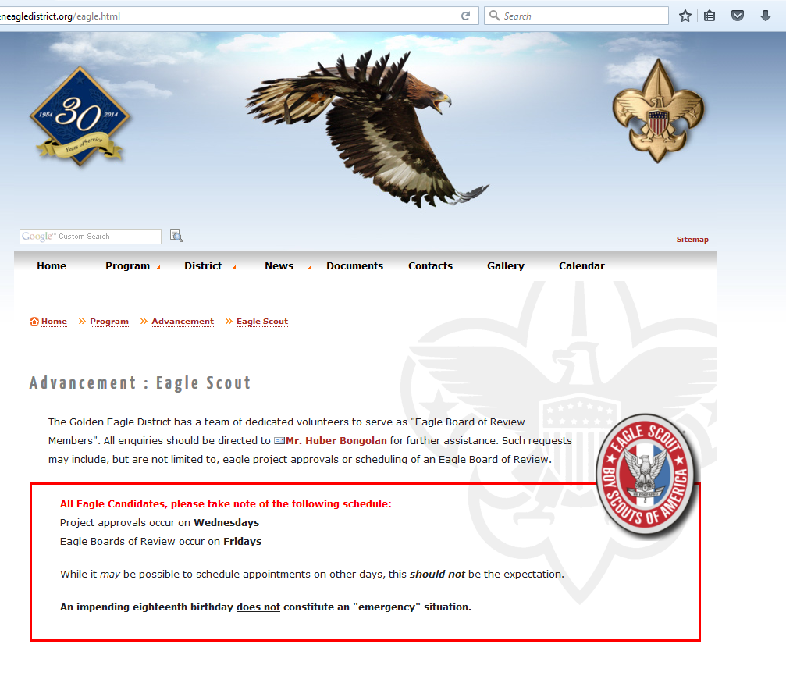
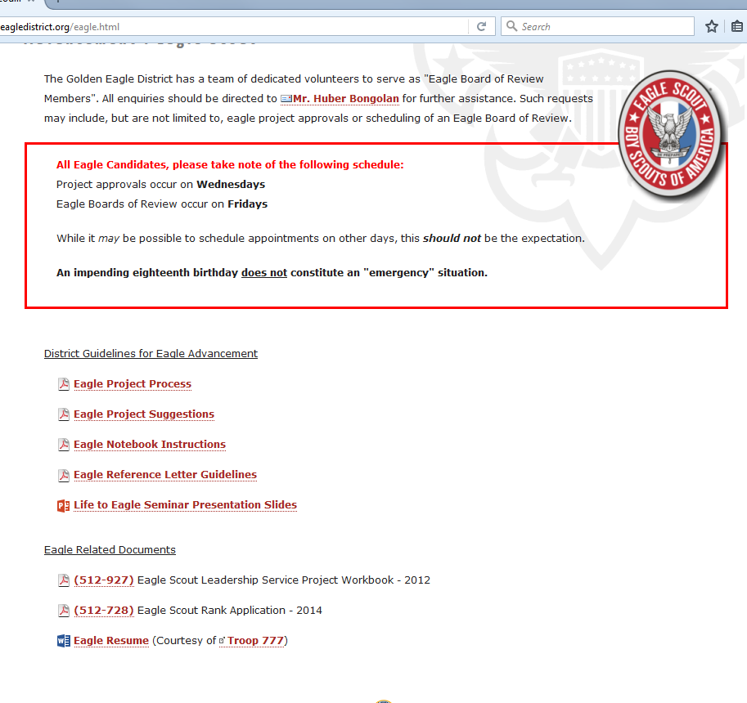
District resources
http://www.goldeneagledistrict.org/eagle.html

Slide 38
Eagle Scout Binder
Purpose
Organizes information into logical structure
Very easy verification
Collects all requested documents
Required
Eagle Scout Application
Life Statement (Eagle Application, Requirement #6)
Eagle Scout Service Project Workbook
Strongly recommended “stuff”
Checklist
Resumé
Advancement Report
Letters of recommendation - * District Chaplain available as an option
Merit Badge Blue Cards
Scouting/Other Awards

Slide 39
Eagle Scout Binder (cont.)
Recommendations
Three-ring binder
Clear-view cover preferred
Cover sheet identifying Scout (name, address, phone, troop)
Tabbed dividers
Clear sheet protectors
Trading card holders (3x3)
Merit badge blue cards
Do a Good Turn! Present the information in a clean, neat, and logical structure.

Slide 40
Eagle Scout Binder (cont.)
Contents
Table of Contents
Checklist
Eagle Scout Rank Application and Requirement #6 (Ambition and Life Purpose
Advancement Report (pre-filled out with Name and Troop Information)
Individual History Report (Troopmaster, etc)
Check for agreement with council records
Strongly encourage using “Internet Advancement”
Eagle Resumé or Participation Report (Troopmaster)

Slide 41
Eagle Scout Binder (cont.)
Contents (cont.)
Eagle Scout Service Project Workbook
Fill out Project Final Plan (“After” summary), including pictures
All signatures in place
Merit Badge Cards (Blue Cards)
Arranged in same order as shown on Eagle Scout Application
Show signature-side up
May include green/white advancement cards
Scouting/Other awards
Letters of Recommendation
The binder is the first impression that Eagle Board members have of the Eagle Scout candidate.

Slide 42
Eagle Scout Board of Review

Slide 43
Eagle Scout Board of Review
Held at St. Matthews United Methodist Church
Available on Fridays, as needed.
Conforms to National and Council policy
Determine quality of Scouting experience
Not a test!
Granted, even if lacking:
Reference letters
Signatures on application
May be cause for “disputed circumstance”
Full uniform (see next slide)
May be granted after 18th birthday

Slide 44
Eagle Scout Board of Review (cont)
Uniforming
Candidates should dress according to importance of occasion
Clean and neat in appearance
Full field uniform is expected
Correct badge placement
In most cases, Scouts can reasonably meet this expectation
Accommodations will be made for:
Unit uniform variance
Any extenuating circumstances
Candidates will not be rejected, under any circumstances, for lack of uniform.

Slide 45
Eagle Scout Board of Review (cont)
Composed of 3-6 members
One of which may be a community leader
Timeline
Review submitted material in Eagle Scout Binder (30-40 min)
Interview all parties
Unit leader (10-20 min)
Parents (10-20 min)
Scout (30-45 min)
Scout Oath, Law, Motto, Slogan, Outdoor Code, Pledge of Allegiance, National Anthem
Ice breaker game (Ranks of Scouting)
Leadership
Service Project
Etcetera

Slide 46
Eagle Scout Board of Review (cont)
Timeline (cont.)
BOR Member Discussion (10 min)
Conclusion (20-30 min)
Notification of decision
Events for new Eagle Scouts
Photos (be sure to bring a camera)
The process takes at least 2 hours!

Slide 47
Post - Eagle Scout Board of Review
Eagle BOR date is official date of becoming an Eagle Scout
During processing (see below), planning for an Eagle Court of Honor may commence
Processing
Eagle Board Chair forwards paperwork to Council (in 2-3 days)
Council reviews paperwork. If approved, forwards to National.
National reviews paperwork. If approved, sends credentials back to Council.
Council will call Scout to pickup Eagle Scout credentials (in 4-6 weeks from submittal to council)
Should pickup as soon as possible

Slide 48
Other Considerations
Disputed Circumstances
During fulfillment of rank requirements.
Convening an Eagle Board or appealing EBOR decision.
Time Extensions
“If a youth foresees that, due to no fault or choice of his own, he will be unable to complete the Eagle Scout rank requirements before age 18, he may apply for a limited time extension. These are rarely granted and reserved only for work on Eagle.”
Special Needs
Youth and adults who are developmentally disabled, or youth with severe physical challenges, may be considered for registration beyond the age of eligibility for their program

Slide 49
Contacts
Contacts
Martín Cárdenas, District Chair, mcardenas@goldeneagledistrict.org
Salvador Rodriguez, District Advancement Chair, srodriguez@goldeneagledistrict.org
Huber Boñgolan, District Eagle Board Chair, hbongolan@goldeneagledistrict.org
We’ll gladly handle solutions - not just problems.

Slide 50
Questions?

Slide 51
(9.0.2.9 Eagle Scout Service Project Coach- Guide to Advancement)
and Unit “Advisors” or “Mentors”

Slide 52
Appointing Coaches: Where Do They Come From?
It is up to the council and/or district to determine:
Who may serve as designated project coaches
How to organize a pool of willing volunteers
How to assign designated coaches to candidates
Unit “mentors” or “advisors”:
Are not the same as designated coaches
Often provide positive contributions
Provide support with project planning and execution
Prepare Scouts to work with designated coaches
Notes:
The council determines who may serve as designated project coaches. The ability to work well with Scouts, knowledge of applicable policies and procedures, and an understanding of how the project contributes to the aims of Scouting are a few parameters to consider in selecting them.
If designated coaches do not take on the day to day mentoring, then each of them should be able to work with a number of Scouts at the same time. Still, depending on the size of the council or the district quite a few coaches may be needed.
Organizing a pool of willing and qualified volunteers is the best approach.
Ask: How would a council or district go about doing this?
Discuss. (Look for: Finding people who have approved project plans in the past, advised Scouts in their unit, served as unit advancement coordinators, or have been members of the council or district advancement committee.)
If there are just not enough people available to form a district or council pool, councils may decide to designate coaches from within a Scout's unit. But regardless the source, or a coach's Scouting position, the designated project coach represents the council or district's perspective. As a Scout plans and executes his Eagle Scout service project, his coach must be able to provide the level of guidance that will help the candidate pass his board of review.
As proposals are approved, coaches should be designated routinely, and Scouts advised that a coach will be calling soon to set up a first meeting. If a young man suggests he doesn't need a coach, he should be counseled on the benefits a coach can provide and encouraged to at least have that first meeting.
Units have often used “mentors" or "advisors” to guide Scouts through the Life to Eagle process, providing that day to day support we’ve discussed. However, it must be understood that "mentors" and "advisors" are not the same as designated coaches. These helpful unit-level volunteers provide a positive contribution, but they have a different perspective. Their efforts should have a focus toward on-going support and encouragement in an effort to prepare a Scout to work with his designated coach. It may also be useful for the "mentor" or "advisor" to touch base now and then with the designated coach to ensure advice given is consistent with council expectations.

Slide 53
Qualifications of Eagle Coaches
Any contact with Scout must be conducted with Youth Protection Procedures (Applies to Unit Advisor/Mentors)
A coach must be a registered member of the BSA
In any adult Scouting position
Current in Youth Protection training
Complete application and be approved
A coach must also have a thorough understanding of the official resources previously mentioned, and especially sections 2, 8, and 9 in the Guide to Advancement.
Encouraged to complete District Training

Slide 54
Eagle Scout Service Project Coach Term of Service and Association
Term of Service: From service project proposal approval to completion of the project report.
The role of the designated project coach is not intended to require a close, frequent association.
Notes:
Since the Eagle Scout service project coach is designated at the council or district level he does not begin work with a Scout until the project proposal is approved. Service should then continue through completion of the project report.
The Eagle Scout service project coach provides guidance, coaching, and consulting to the Scout on how to successfully plan and execute a project that will fulfill requirement 5. The coach should not become a day to day mentor. This limitation allows designated coaches to work with several Eagle Scout candidates simultaneously.
Just as units work on a day to day basis in the rest of the advancement program, so should units provide the day to day mentoring to help Scouts through the service project process. Designated coaches, with their expertise and objective perspective, should supplement assistance from the unit. They should not supplant unit efforts.

Slide 55
Project Coach
A registered Scout Leader from the council, district, or unit level who is knowledgeable and experienced with project approvals.
Though it is a Scout’s option, Coaches are highly recommended to help evaluate a plan and discuss its strengths, weaknesses, and risks.
Coaches shall not have the authority to dictate changes, withdraw approval, or take any other such directive action. (Same for Unit Mentor or Advisor)

Slide 56
The Role of the Designated Coach Different from the Life to Eagle “Mentor”
 | Life to Eagle “Mentor” | Eagle Scout Service Project Coach
Term: | Entire Life to Eagle process | From proposal approval through project report
Focus: | Successful achievement of the Eagle Scout rank. | Successful fulfillment of requirement 5
Appointment | Usually by the unit | By the council or district
Relationship: | Longer-term | Shorter-term
Approach: | Coaching and mentoring in general | Coaching and consulting on the project
Notes:
The position of Life to Eagle “mentor” or "advisor" is not actually an official BSA position, but as we’ve discussed, they can provide a valuable service. In many cases, however, they are confused with the designated Eagle Scout service project coach.
We’ve listed a few differences on this slide. Are there other differences?
Discuss.
(If it doesn't come out in the discussion, explain that these individuals working together can help candidates improve their chances for successfully meeting requirement 5.)

Slide 57
The Role of the Eagle Coach
An Eagle coach’s advice is a key to success.
Serves as an advisor, consultant, coach.
Use the BSA method of positive adult association, logic, and common sense to help the candidate make wise decisions.
Is a resource, encouraging the candidate to fully plan his project, secure resources, and to make wise decisions.
Uses positive adult association, logic, and common sense to help the candidate to reach a successful outcome.
Notes:
It cannot be said too often. A project coach is the key to success in council or district efforts to guide Scouts through the service project process.
And, yes, a coach serves as an advisor and consultant, and helps in other ways, but he does so without directing the Scout. Instead, he must use the BSA method of positive adult association, and also logic and common sense to help the candidate achieve success. (Ask for discussion on how a coach might do this.)

Slide 58
Guidelines for Coaches
Adheres to the Eagle Scout service project process as described in Guide to Advancement, topic 9.0.2.9.
Has no authority to dictate changes, or withdraw approval that was previously granted.
Strives to make his or her involvement a positive experience.
Encourages a Scout to make the kinds of decisions that will lead to successful outcomes.
Notes:
Topic 9.0.2.9 of the Guide to Advancement provides information and guidance on the intended duties and responsibilities of an Eagle Scout service project coach.
A coach's role is to support the Scout and to guide him toward making the kinds of decisions that will help him meet requirement 5. Coaches do not have the authority to dictate changes, withdraw approval previously granted by the district or council, or to take any other directive action.
Instead, Eagle Scout service project coaches strive for a positive experience by encouraging Scouts to make wise decisions and follow logical processes as they work through the requirement. In this way we assist the Scout to become successful not just with his project, but we provide an experience that will help him throughout his life.

Slide 59
Bringing Scouts and Coaches Together
A coach should be designated for every Scout whose proposal is approved.
The assigned coach contacts the Scout, suggests a first meeting, telephone call, e-mail discussion, or video conference.
The Scout may choose not to accept the assistance of the coach, but should be counseled on the value a coach can add.
Notes:
Once a Scout’s project proposal is approved, a coach should be designated immediately. Don't ask the Scout if he wants the help of a coach. He has signed that he’s read the workbook so we may assume he knows coaches are not required. If he doesn’t want one, he will tell us. The best practice is to provide the coach's name and tell the Scout to expect a call.
The designated coach should make contact as soon as practical after the proposal is approved. Time constraints often create challenges for Scouts to complete their projects by the time they turn 18. The sooner a coach makes contact, the better.
A coach’s work with a Scout can be through face-to-face meetings, telephone calls, e-mail, or by video conferencing, but face-to-face is preferred. Regardless the method of contact, discussions with the Scout should be relaxed, respectful, helpful, friendly, courteous, kind... Well you get the picture.

Slide 60
Unit Mentors or Advisors
9.0.2.9 – Guide to Advancement
Many units have used service project “mentors” or
“advisors” through the decades since the Eagle Scout
service project came to be. This practice has provided
consistent positive contributions and should continue.
Any contact with Scout must be conducted with Youth Protection Procedures (Applies to Unit Advisor/Mentors)
Unit Eagle Advisors/Mentors must adhere to the Eagle Scout service project process as described in this section of the Guide to Advancement.

Slide 61
Unit Mentors or Advisors
9.0.2.9 – Guide to Advancement
Use the BSA method of positive adult association, logic, and common sense to help the candidate make wise decisions.
Their efforts, however, should serve to provide ongoing
support throughout project planning and execution and to
prepare a Scout to work with the council or district
designated project coach.
Unit Mentors or Advisors do not have approval authority. Instead they serve to encourage—not direct—the young men to make
the kinds of decisions that will lead to successful outcomes.

Slide 62
Unit Mentors or Advisors
9.0.2.9 – Guide to Advancement
It is true a Scout need not accept the assistance of the
service project coach.
Regardless, it is considered best for the council or district to designate one for every Scout who submits a project proposal for approval.

Slide 63
Thank you for coming!

