Slide 1
Life to Eagle Seminar
Golden Eagle District
Greater Los Angeles Area Council
July 7, 2018
www.goldeneagledistrict.org

Slide 2
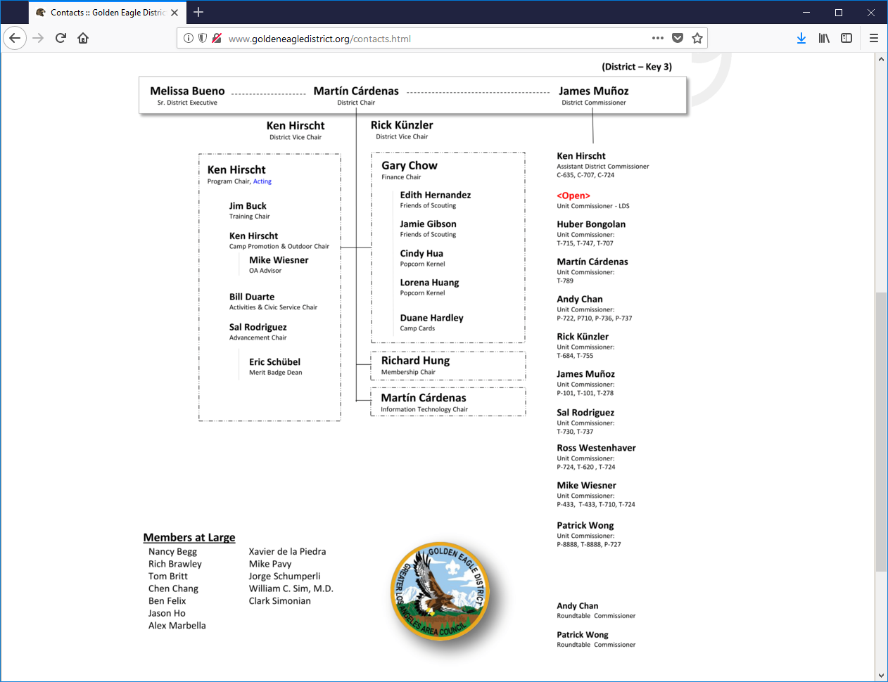

Slide 3
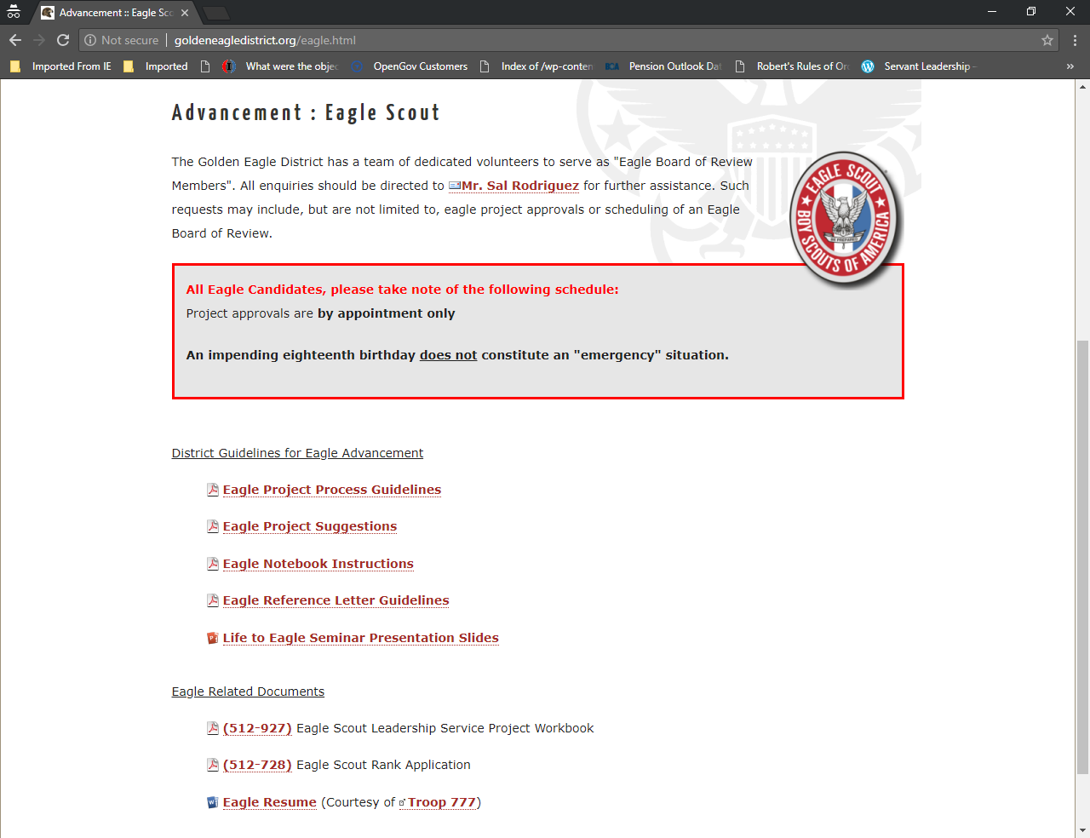
District resources
http://www.goldeneagledistrict.org/eagle.html

Slide 4

Eagle Scout Rank
Earning the rank of Eagle Scout is a special event. Fewer than 5% of Scouts earn this distinction each year.

Slide 5
Agenda
Introductions
Review for Eagle Scout Rank Requirements
Discuss Troop (Unit) Eagle Advisor or Mentor
Discuss Eagle Scout Project approval process
Discuss Eagle Scout Service Project
Review Eagle Application Process
Discuss Eagle Scout Binder
Discuss Eagle Board of Review

Slide 6
Introductions
Tell us:
  Your name.
  Troop #.
  Your position in your unit.
  Why are you here?
  We will take any specific questions at the end of the presentation.

Slide 7
The Trail to Eagle -
How Can Parents/Guardians Help?
Accept that your son owns the process.
Have an honest discussion about making Eagle.
Ask about his planned schedule for completing Eagle requirements.
Show interest and encouragement. Avoid “incentives”.
Ask about progress, but not too frequently.
Be helpful, but not too helpful.
7
Notes:
7

Slide 8
Eagle Scout Rank Requirements

Slide 9
Eagle Scout Requirements
Active as Life Scout * 6 month minimum
Scout Spirit (Oath and Law) *
and Duty to God.
Merit Badges * 21 minimum
Leadership Position * 6 month active
Eagle Scout Service Project *
Scoutmaster Conference *
Complete Eagle Board of Review
* All requirements, except Board of Review, must be completed before 18th birthday!

Slide 10
Eagle Requirements (cont.)
Be active in your troop, team, crew, or ship for a period of at least six months after you have achieved the rank of Life Scout.
BSA Guide to Advancement 2017 4.2.3.1 Active Participation
Three sequential tests used to determine where Active requirement has
been met. The first and second are required, along with the third or
its alternative.
Three tests
The Scout is registered.
The Scout is in good standing, not suspended for discipline.
The Scout meets the unit’s reasonable expectations, or if not,
a lesser level of activity is explained.
It is appropriate for units to set reasonable expectations; or if not, a lesser level of activity is explained.

Slide 11
Test 3- The Scout meets the unit’s reasonable expectations, or if not, a lesser level of activity is explained.
If, for the time period required, a Scout or qualifying
meets those aspects of his Unit’s pre-established expectations that refer to a level of activity, then he is considered active and the
requirement is met.
Time counted as “active” need not be consecutive. A boy may piece together any times he has been active and still qualify. If he does not meet his unit’s reasonable expectations, then he
must be offered the alternative that follows.

Slide 12
Test 3- The Scout meets the unit’s reasonable expectations, or if not, a lesser level of activity is explained.
Alternative to the third test if expectations are not met:
If a young man has fallen below his unit’s activity oriented
expectations, then it must be due to other positive endeavors—in or out of Scouting—or due to noteworthy circumstances that have prevented a higher level of participation.

Slide 13
Eagle Requirements (cont.)
2. As a Life Scout, demonstrate Scout Spirit by living the Scout
Oath and Scout Law. Tell how you have done your duty to God,
how you have lived the Scout Oath and Scout Law in your
everyday life, and how your understanding of the Scout Oath
and Scout Law will guide your life in the future.
List on your Eagle Scout Rank Application the names of individuals who
know you personally and would be willing to provide a recommendation on your behalf, including parents/guardians,
religious (if not affiliated with an organized religion, then
the parent or guardian provides this reference), educational,
employer (if employed), and two other references
Evaluating Scout spirit will always be a judgment call, but through getting to know a young man and by asking probing questions…

Slide 14
Tips for success Letters of Reference
Start talking now to potential Adults, Scout Leaders, Teachers, Religious Reference, employer for letters of reference
Letters of reference need to be sealed.
If you do not have a religious reference. Your Parent/Guardian can provide a religious reference letter.
Please provide recommenders District Letter of Reference information
http://goldeneagledistrict.org/docs/Advancement/EagleScout-ReferenceLetter.pdf

Slide 15
Requirement 2 Scout Spirit continued
Demonstrate that you live by the principles of the Scout Oath and Law in your daily life.
This IS about abiding by the principles of the Scout Oath and Law in everything that you do.
This requirement is NOT for how you act in your Unit, but how you live your life!

Slide 16
Eagle Requirements (cont.)
Earn a total of 21 merit badges (10 more than you already have), including these 13 merit badges:
List of merit badges…
(a) First Aid, (b) Citizenship in the Community,
(c) Citizenship in the Nation, (d) Citizenship in the World,
(e) Communication, (f) Cooking, (g) Personal Fitness
(h) Emergency Preparedness OR Lifesaving,
Environmental Science OR Sustainability,
(j) Personal Management,
(k) Swimming OR Hiking OR Cycling,
(l) Camping, and (m) Family Life.
You must choose only one of the merit badges listed in categories h, i, and k.
Several merit badges require extended periods of time to complete!

Slide 17
Merit Badges and Scouts with Disabilities
There are special exceptions for Scouts with disabilities
Contact the District Eagle Board Chair or District Advancement Chair for guidance

Slide 18
Eagle Requirements (cont.)
While a Life Scout, serve actively for a period of 6 months in one or more of the following positions of responsibility:
List of positions…
While a Life Scout, serve actively in your troop for six months
in one or more of the following positions of responsibility:
Boy Scout Troop - Senior Patrol leader, Assistant Senior Patrol Leader, Patrol Leader, Troop Guide, Order of the Arrow Troop
Representative, Den Chief, Scribe, Librarian, Historian, Quartermaster, Junior Assistant Scoutmaster, Chaplain Aide, Instructor, Webmaster, or Outdoor Ethics Guide. Assistant Patrol Leader does not qualify.
When a Scout assumes a position of responsibility, there is an expectation that something must happen.

Slide 19
Serve Actively in your Position of Responsibility
Time carried on the unit records in the position is all that is required.
You do not have to hold one position for six (6) months.
You do not have to hold the position for six (6)
consecutive months.
You may meet this requirement any time while a Life Scout.

Slide 20
Performance in the Position of Responsibility
A Scout may not be held to an extraordinary, undefined, or unknown standard of performance.
The standard of performance used to measure this requirement shall be the same as that applied to other Star, Life or Eagle Scout candidates.

Slide 21
Eagle Requirements (cont.)
While a Life Scout, plan, develop, and give leadership to others in a service project helpful to any religious institution, any school, or your community. (The project must benefit an organization other than Boy Scouting.) A project proposal must be approved by the organization benefiting from the effort, your unit leader and unit committee, and the council or district before you start. You must use the Eagle Scout Service Project Workbook, BSA publication No. 512-927, in meeting this requirement. (To learn more about the Eagle Scout service project, see the Guide to Advancement, topics 9.0.2.0 through 9.0.2.16.)
The key is to “plan, develop, and give leadership”…
(More on this later.)

Slide 22
Eagle Requirements (cont.)
Take part in a Scoutmaster conference.
A Scoutmaster conference is a positive experience, the objective of which is to help a Scout evaluate his accomplishments and set new goals. Even goals beyond the rank of Eagle and/or the age of 18.
Requirement does not say to “pass” a conference. It is also not required to be the last step before a Board of Review.

Slide 23
Scoutmaster Conference - continued
When there is a reason to believe that an Eagle candidate will not be qualified to achieve the Eagle Scout award within the six month period prior to his eighteenth birthday, the unit leader is obligated to initiate a counseling session, on a timely basis, so as to give the Eagle candidate every reasonable opportunity to become qualified.

Slide 24
Eagle Requirements (cont.)
Successfully complete an Eagle Scout board of review. (This requirement may be met after age 18, in accordance with Guide to Advancement topic 8.0.3.1.11).
In preparation of your board of review, prepare and attach to your Eagle Scout Rank Application a statement of your ambitions and life purpose and a listing of positions held in your religious institution, school, camp, community, or other organizations, during which you demonstrated leadership skills. Include honors and awards received during this service.
Conducted by the Golden Eagle District Advancement Committee.
(More on this later.)

Slide 25
Eagle Scout Service Project

Slide 26
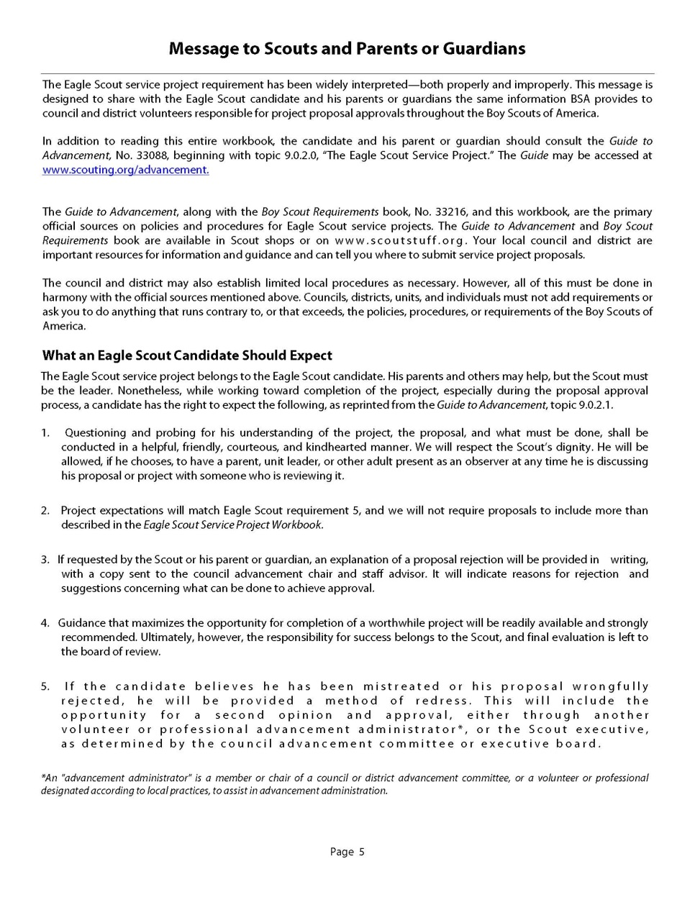
Message to Scouts and Parents or Guardians
Read and review this section of the Eagle Project Workbook.
It indicates appropriate expectations for Scouts and their parents.
“The Eagle Scout service project belongs to the Eagle Scout candidate. His parents and others may help, but the Scout must be the leader.”
26
Notes:
a. There is a new “Message From the Chief Scout Executive” and picture.
b. “Scouts and Parents or Guardians” box updated.
c. Other two boxes (“Only the Official Workbook May Be Used”, “Attention: Unit, District, and Council Reviewers”) moved to this page, from Contents page and updated.
d. Section on “Completing This Workbook” removed and integrated into other areas
26

Slide 27
Message to Scouts and Parents or Guardians
What Scouts Can Expect:
Project reviews will be conducted in a friendly, kindhearted manner.
Scouts may have a parent present as an observer.
No one can demand more work than what is described in the Project Workbook.
Responsibility for success belongs to the Scout.
Scouts have recourse if their project proposal is not approved.
27
Notes:
a. There is a new “Message From the Chief Scout Executive” and picture.
b. “Scouts and Parents or Guardians” box updated.
c. Other two boxes (“Only the Official Workbook May Be Used”, “Attention: Unit, District, and Council Reviewers”) moved to this page, from Contents page and updated.
d. Section on “Completing This Workbook” removed and integrated into other areas
27

Slide 28
Choosing a Project
What schools, churches and community groups have influenced your life? Are they non-profit and non-BSA?
Who would you contact to find how to help?
What needs to be done for these groups?
Projects can not be done for your Council, Troop, or for the District.

Slide 29
Eagle Scout Service Project
It’s all about showing LEADERSHIP.
You may start planning your Eagle Scout Service Project just as soon after achieving the rank of Life Scout as is practical.
All work on your Eagle Service Project must be undertaken while you are a Life Scout and completed before your eighteenth birthday.

Slide 30
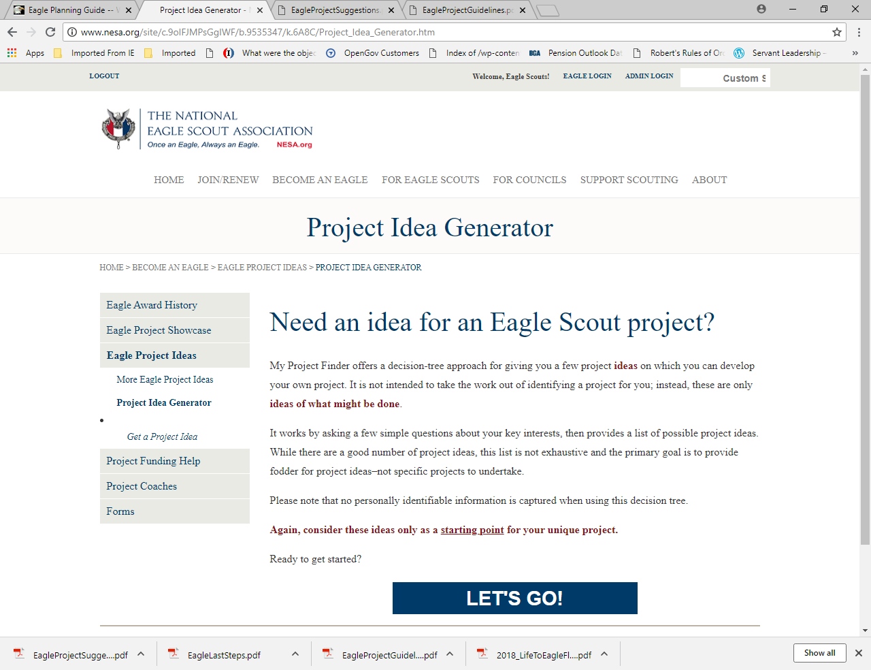
http://www.nesa.org/site/c.9oIFJMPsGgIWF/b.9535347/k.6A8C/Project_Idea_Generator.htm

Slide 31
Eagle Scout Service Project
Guidelines
  Present opportunity for planning, development, and leadership
  Projects must
    benefit a religious institution, school, or community
  Projects must not be
    of a commercial nature
    only routine labor
    only a fundraiser
    joint projects – only one Eagle candidate can receive credit for the same project
    performed for the Boy Scouts of America, councils, districts, units, or its properties

Slide 32
Fund Raising Eagle Project
Fundraising is not a requirement. Fundraising must not be part of the project itself.
The Eagle Scout Service Project Fundraising Application must be used in obtaining approval for service project.
All money left over, regardless of the source, goes
to the beneficiary of the Eagle project.
Fundraising must conform to the Guide to Safe Scouting (Parental Consent, Supervision, and safety of utmost importance).

Slide 33
Eagle Scout Service Project (cont)
Approvals
  Must use Eagle Scout Project Workbook 512-927
  (Read and understand the entire document before filling-out)
    Eagle Scout Project Proposal (required)
      All areas must be addressed – indicate not applicable “N/A” where necessary
      Must include sufficient details to determine project viability
        Include pictures and sketches/drawings
      Important Considerations
        Fundraising Applications – only if needed
        Time – recommend 3-4 weeks after approval to perform project.
    Eagle Scout Project Plan (not required, but strongly recommended)
      Unit Leader is encouraged to review this in order to ensure a successful project

Slide 34
Eagle Scout Service Project (cont)
Approvals (cont.)
  Proposals must be approved before starting the project.
    Unit Leader
    Unit Committee Member
    Beneficiary Representative
    District Representative –District Advancement Chair
  Contact:
    Mr. Sal Rodriguez, District Advancement Chair – srodriguez@goldeneagledistrict.org
Eagle Candidates are expected to make a reasonable effort to present themselves in full uniform. (More on this later.)

Slide 35
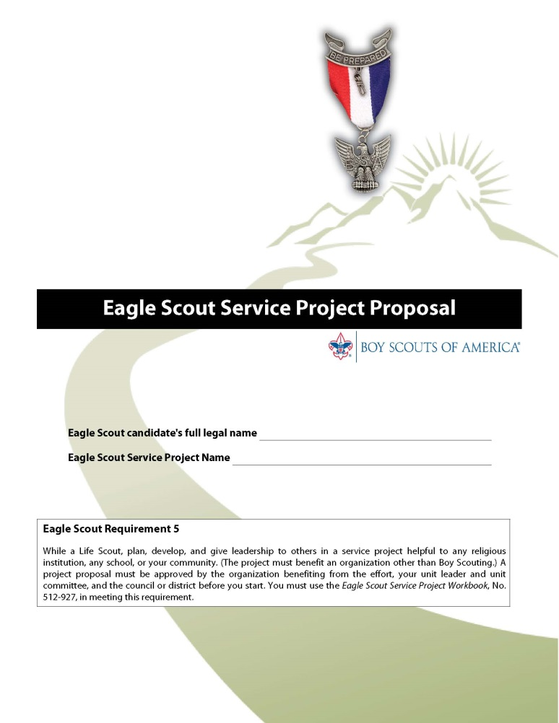
PROJECT PROPOSAL
A Scout should start his Project Proposal when he has:
A good project concept
A potential sponsor
Discussed his ideas with his unit Eagle Advisor and/or Unit Leader
Computer entry is very desirable

Slide 36
9.0.2.14 Risk Management and Eagle Scout Service Projects – Guide to Advancement
Unit leadership should be aware of project plans and schedules. The health and safety of those working on Eagle projects must be integrated into project execution.
Since an Eagle Scout service project is a unit activity, unit adult leadership has the same responsibility to assure safety in conducting a project as with any other unit activity.
The unit leader or unit committee should reject proposals for inherently unsafe projects. The candidate should plan for safe execution, but it must be understood that minors cannot and must not be held responsible for safety concerns.

Slide 37
RISK MANAGEMENT
37
GTA §9.0.2.14
Eagle projects are official Scouting activities and must conform to applicable BSA policies and procedures.
The Scout’s unit has the same safety responsibilities as any other unit activity.
BSA safety standards include Youth Protection, two-deep leadership, Buddy System for Youth, tool safety, and other provisions in the Guide to Safe Scouting.
An “approved” Eagle Project may be stopped by any adult if required based on safety concerns.
Adult leader knows CPR, First Aid kit, Information on nearest Urgent Care Center and Hospital
Notes:
37
37

Slide 38
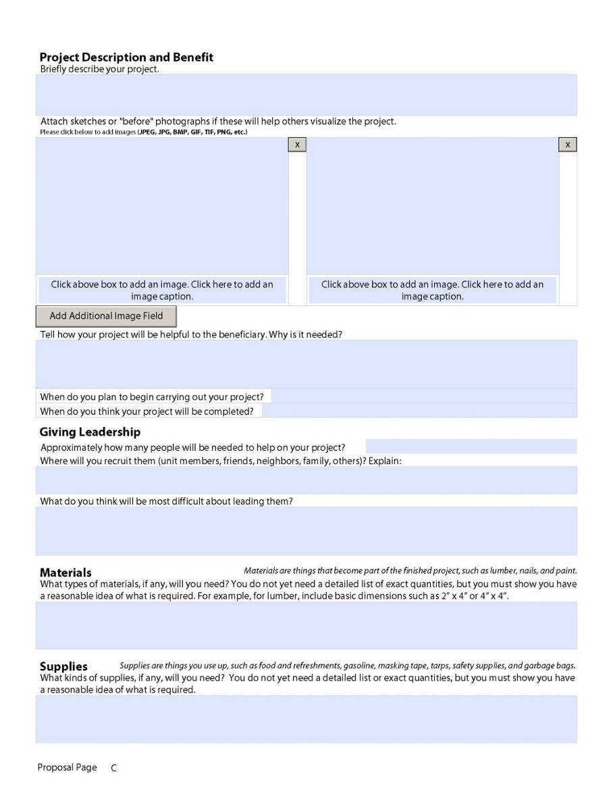
Proposal Page C
Description & Benefit
Pictures and Captions
Giving Leadership
Materials
Supplies
38
Notes:
38

Slide 39
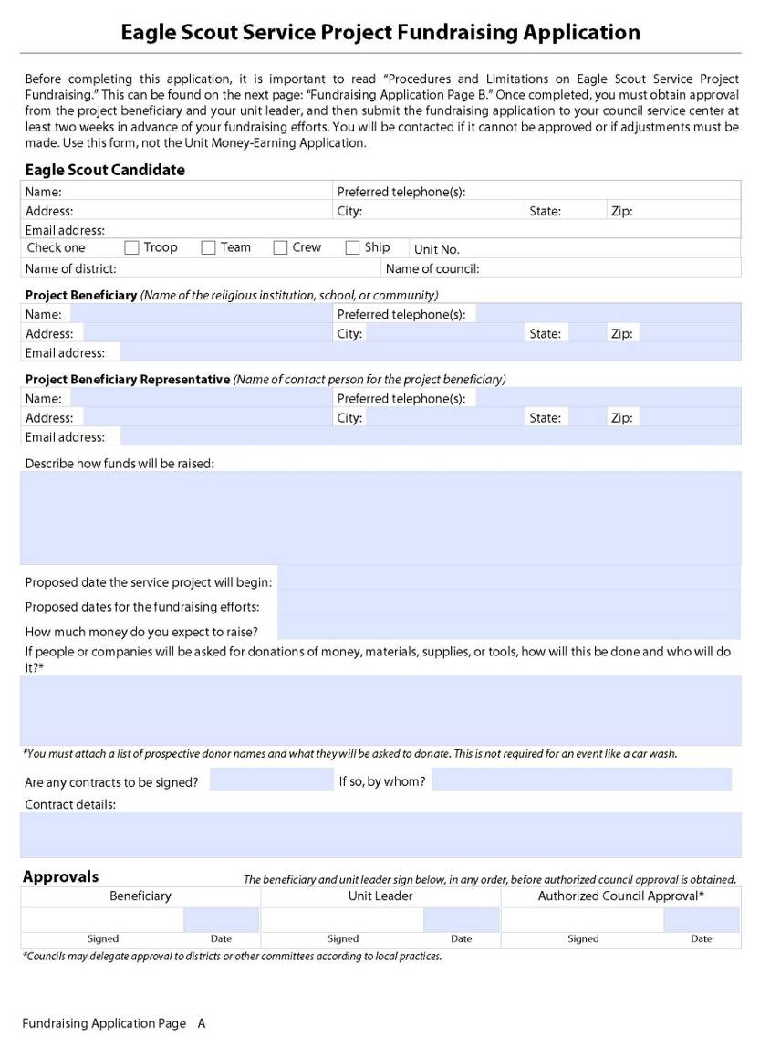
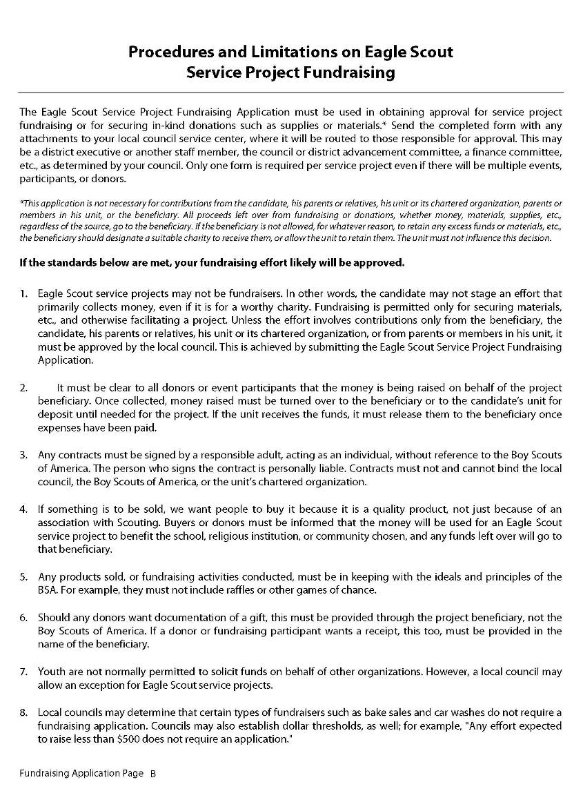
Project Fundraising
The Workbook includes a Fundraising Application
No Application is needed for donations from:
The Scout or his relatives
The Scout’s Unit or Chartered Organization
Other members of the Scout’s Unit
The Project beneficiary
If donations from other sources do not exceed $500, the Fundraising Application is not required.
The Project Proposal and Plan describe how materials will be obtained and expenses paid. The Project Report describes the disposition of excess donations.
39
Notes:
39

Slide 40
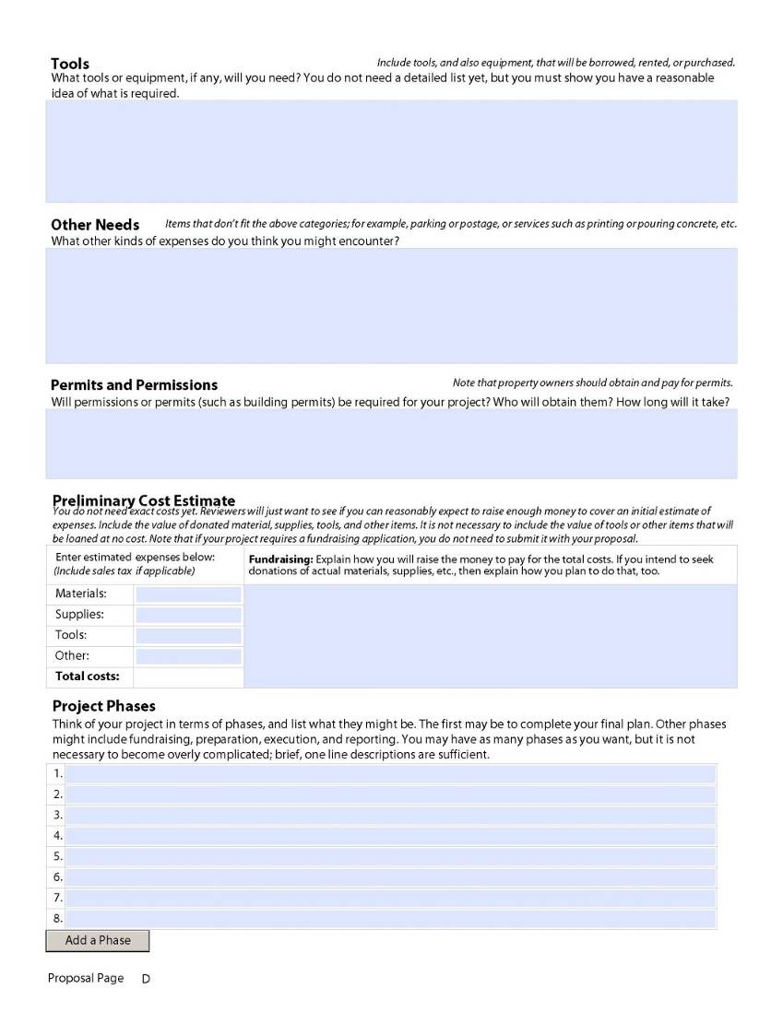
Proposal Page D
Tools
Other Needs
Permits & Permissions –
Tour Permit if the location is remote
Prelim Cost Estimate, Funding and Donations
Project Phases
40
Notes:
40

Slide 41
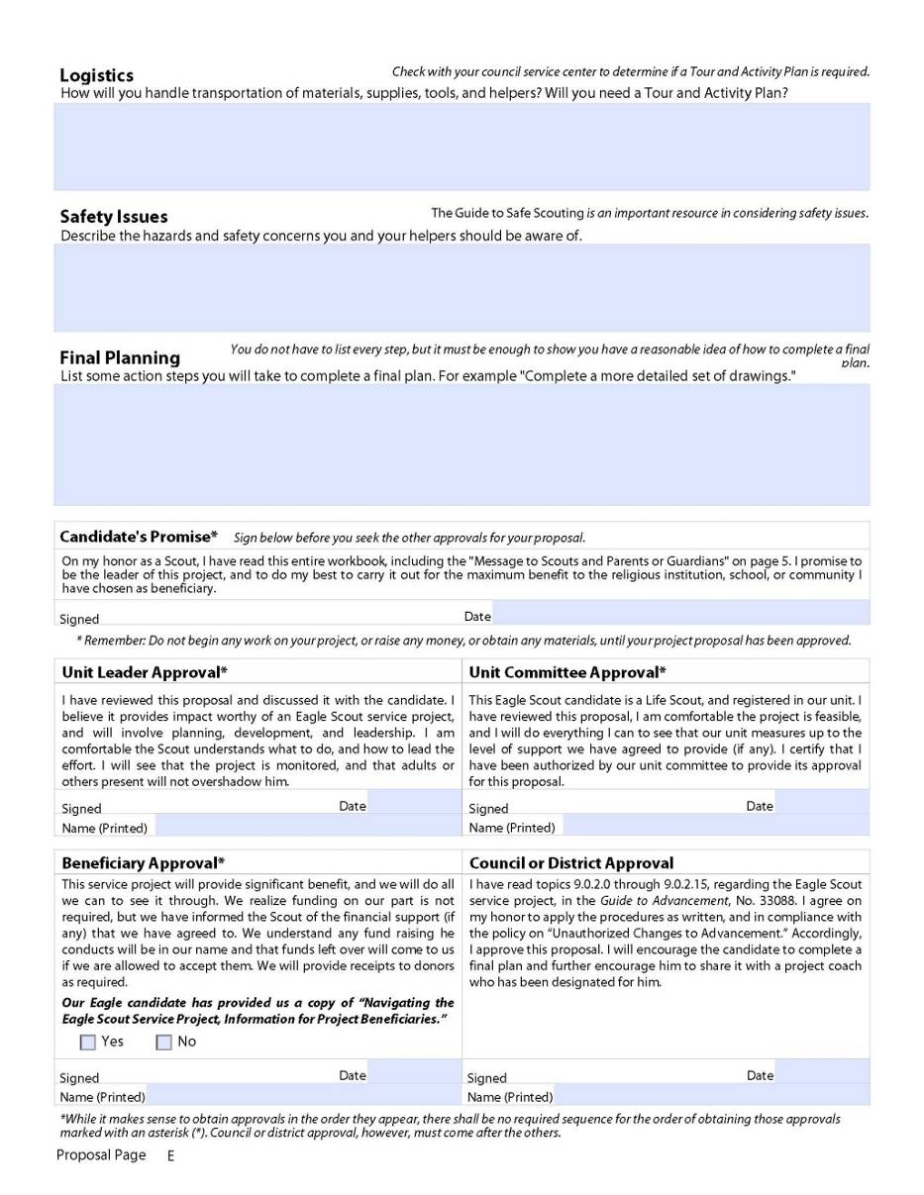
Proposal Page E
Logistics
Safety! – Safety! – Safety!
Final Planning
Candidate’s Promise
Approval Signatures
41
Notes:
41

Slide 42
9.0.2.7 “Proposal Must Be Approved … Before You Start” – Guide to Advancement
The Five Tests of an Acceptable Eagle Scout Service Project. The proposal is an overview, but also the beginnings of planning. It shows the unit leader and any representatives of a unit committee, council, or district, that the following tests can be met.
1. The project provides sufficient opportunity to meet the requirement.
2. The project appears to be feasible.
3. Safety issues will be addressed.
4. Action steps for further detailed planning are included.
5. The young man is on the right track with a reasonable chance for a positive experience.
The detail required for a proposal depends on project complexity. It must be enough to provide a level of confidence for a council or district reviewer that the above tests can be met, but not so much that—based on the possibility a proposal can be rejected—it does not respect the time it takes to prepare.

Slide 43
Life to Eagle Signature Cycle
Discuss with
Unit Leader
Scout Reads &
Signs Book
Get an Idea
OK
Meet with
Beneficiary
Beneficiary
Signature *
Not OK
Not OK
Start Here
Present to
Committee
Proposal
District
Approver
Signature
Unit Leader
Signature *
OK
Committee
Signature *
District
Approver
Signature
Not OK
Prepare Final Plans
Prepare Final Plans
* Beneficiary Signature may be obtained prior to Unit Leader’s or Committee signature
Meet with Beneficiary to review Plans
District signature MUST be the last to be obtained
Do Project
Do Project

Slide 44
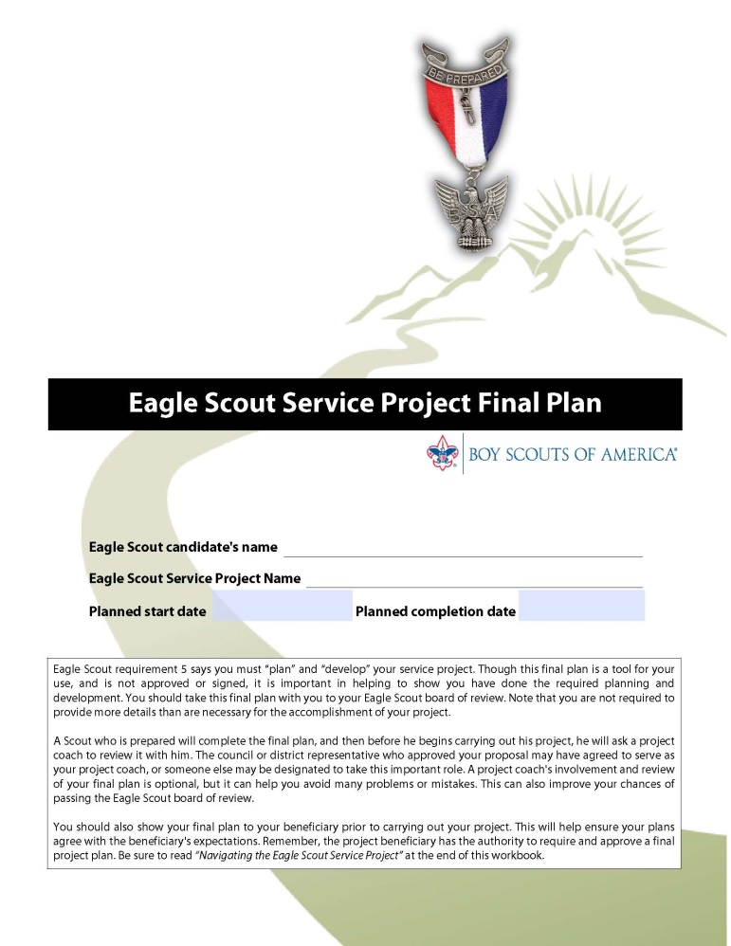
PROJECT PLAN
The goal is to ensure that:
Critical issues are understood and resolved
All preparation tasks are described in detail
Leadership roles and responsibilities are defined
Clear step-by-step process
Level of detail depends on complexity and risks.
Any major change may require project re-approval!
44
Notes:
Under “The Final Plan”, an important sentence was added: “No one approves it, although your project beneficiary has the authority to review it and require changes in it.”
Text added that covers handling, development, and potential beneficiary approval of the final plan.
44

Slide 45
PROJECT PLAN
45
Review of the Plan:
The project is approved based on the Project Proposal.
The Project Plan must be reviewed by the Beneficiary who can demand improvements before the project proceeds.
The Scout’s Eagle Advisor or Project Coach should review the Plan to ensure it is adequate.
The Scout’s Eagle Board will evaluate the Plan, how the Scout demonstrated leadership, and the successfulness of the project.
Notes:
45

Slide 46
CONDUCTING THE PROJECT
The Eagle candidate must be the project leader. The project is about leadership and service to others.
Preparation tasks before the day of the project are the hidden keys to success.
Most projects should have a management team with duties assigned by the project leader.
Scouts should record notes and observations immediately after each day of project activity.
46
Notes:
46
46

Slide 47
CONDUCTING THE PROJECT
Adult duties can include:
Use of power tools and motor vehicles
Two-deep supervision and safety monitoring
Logistic support (food, sign-in table, security, photo documentation)
Other tasks, provided the work is directed by the Eagle candidate
Adults should avoid directing project activities.
Adult suggestions should be offered for consideration by the project leader.
47
Notes:
47
47

Slide 48
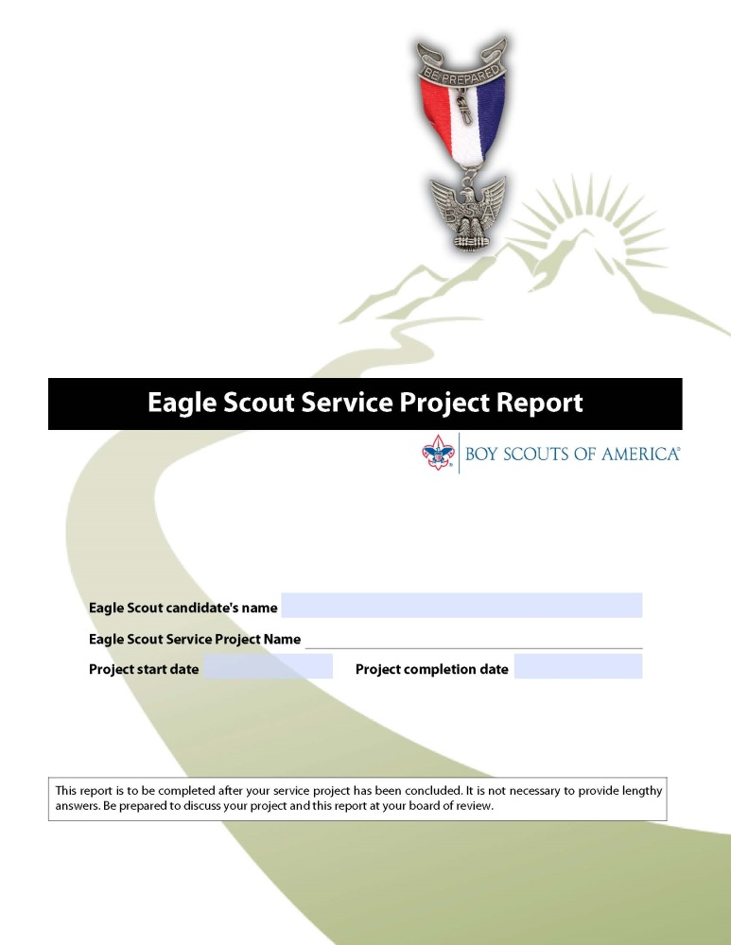
PROJECT REPORT
Describes what was accomplished and what lessons were learned.
Project Beneficiary and Unit Leader sign to document the project is satisfactory and complete.
The Scout’s Eagle Board will review and evaluate the Project Report.
48
Notes:
48

Slide 49
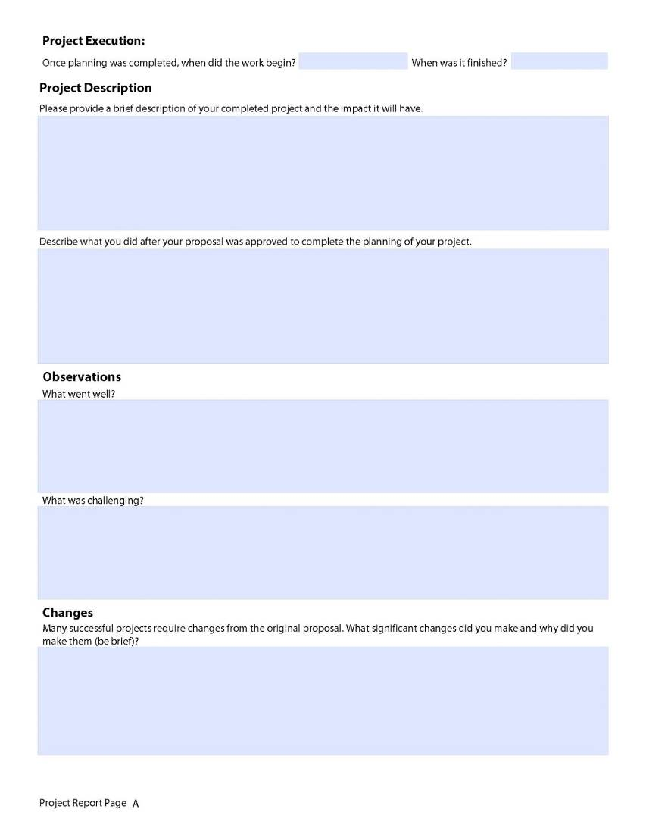
Project Report Page A
Project Date(s):
Project Description
Successful and Challenging Aspects
Changes
49
Notes:
49

Slide 50
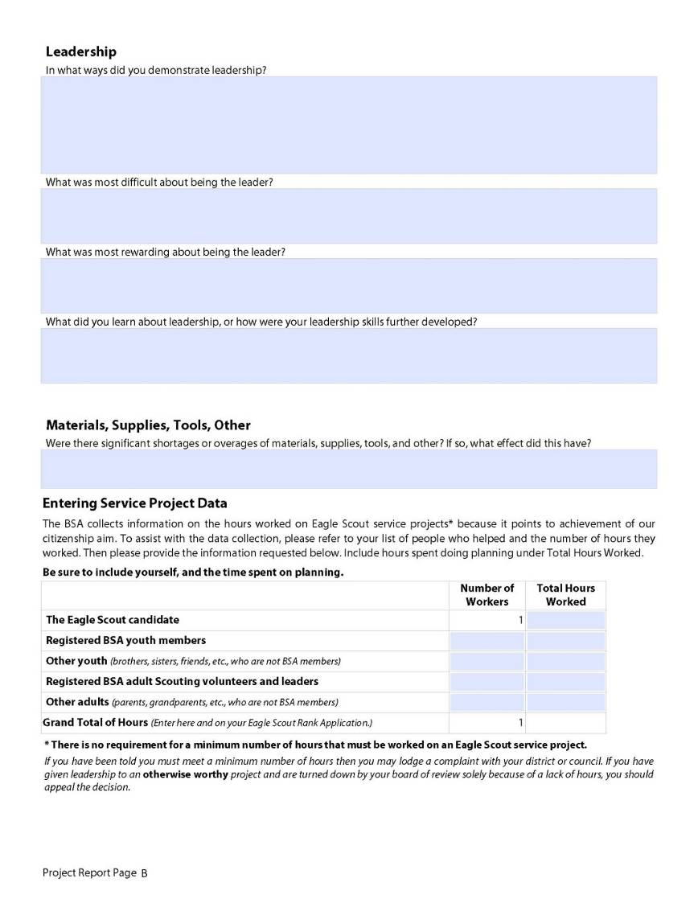
Project Report Page B
Leadership Issues
Materials
Service Hours
50
Notes:
.
50

Slide 51
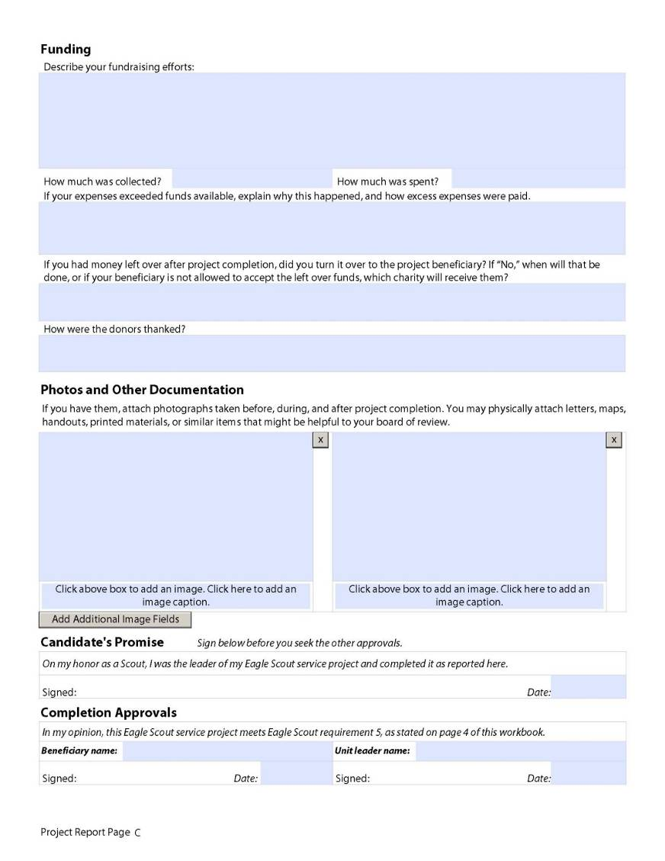
Project Report Page C
Funding Issues
Photos and Other Documents
Completion Approvals
51
Notes:
51

Slide 52
Preliminary Cost Estimate - expanded notes to include guidance on donated materials, loaned tools/items, and the fundraising application.
Funding - the question regarding leftover funds was clarified to be consistent with other fundraising application guidance. - Listing of fundraising revenues and expenses help provide additional information on how well as Scout you are Thrifty
Photos and Other Documentation – Pictures of your Eagle Project with caption label support the report to help the Eagle Board evaluate your leadership

Slide 53
Troop (Unit) Eagle Advisor/Mentor

Slide 54
Troop (Unit) Eagle Mentors or Advisors
9.0.2.9 – Guide to Advancement
Many Troops (units) have used service project Eagle “mentors” or “advisors” through the decades since the Eagle Scout service project. Eagle mentor/advisor must be registered and complete Youth Protection Training .
Any contact with Scout must be conducted with Youth Protection Procedures (Applies to Troop (Unit) Eagle Advisor/Mentors)
Strives to make his or her involvement a positive experience.
Troop (Unit Eagle) Advisors/Mentors must follow the Eagle Scout service project process as described in this section of the Guide to Advancement.

Slide 55
Troop (Unit) Eagle Mentors or Advisors
9.0.2.9 – Guide to Advancement
Troop (Unit Eagle) Advisors/Mentors do not have approval authority.
Instead they serve to encourage—not direct—the Scout to make the kinds of decisions that will lead to successful outcomes.
The Scout may choose not to accept the assistance of the coach, but should be counseled on the value a coach can add.

Slide 56
Be Aware……
NO Council, District, Unit or Individual has the authority to
ADD to or SUBTRACT from any BSA advancement requirement
56

Slide 57
Eagle Scout Application Process

Slide 58
Eagle Scout Application Process
Complete all requirements
Prepare Eagle Scout binder
  Complete the Eagle Scout Application
    Obtain required signatures – process for “disputed circumstances”
  Life Statement (Eagle Application, Requirement #6)
  Eagle Scout Service Project Workbook
    Obtain required signatures
  Other strongly recommended “stuff”
Submit entire package to District Advancement Chair/Eagle Board Chair
Information is verified
Eagle Scout Board of Review is scheduled

Slide 59
Statement of Ambitions and Life Purpose
Statement of Ambitions and Life Purpose. Purpose A short statement (few paragraphs in length (several sentences) describing ambitions, life goals, etc.
Attach to your Eagle Scout Award Application a statement of your ambitions, life purpose, and a listing of positions held in your religious institution, school, camp, community or other organizations during which you demonstrated leadership skills.
Include any honors and awards received during this service.

Slide 60
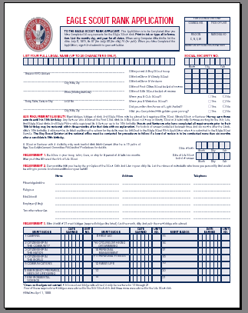
Eagle Rank Application
Fill it out completely
List references as requested
Be sure all dates are correct
Include unit numbers for merit badges
List only 21 merit badges
Complete and sign the back side
Attach to your project
Workbook Always check to see if you have the current version (www.nesa.org or www.scouting.org )
60

Slide 61
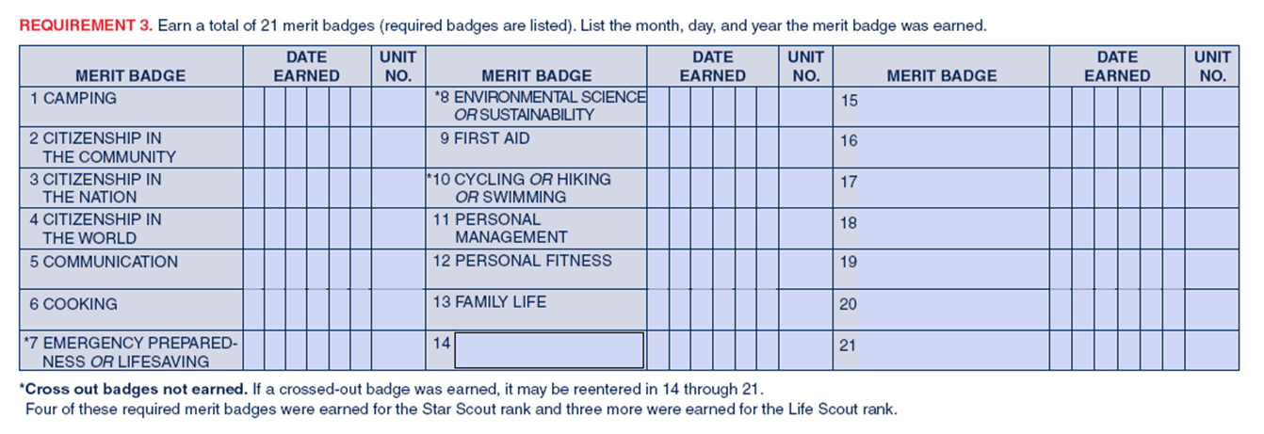
Requirement 3 – Merit Badges
Record a total of 21 merit badges (13 required badges).
The dates are important and must match BSA records.
Reconcile any differences using blue card records.
61
Notes:
61
61

Slide 62
Eagle Notebook/Binder

Slide 63
Eagle Notebook/Binder
Purpose
  Organizes information into logical structure
  Very easy verification (see District website for document on preparing Eagle Scout Notebook/binder)
  Collects all requested documents
    Required
      Eagle Scout Application
      Life Statement (Eagle Application, Requirement #6)
      Eagle Scout Service Project Workbook
    Strongly recommended “stuff”
      Checklist
      Eagle Statement
      Resumé
      Advancement Report
      Letters of recommendation - * District Chaplain available as an option
      Merit Badge Blue Cards
      Scouting/Other Awards

Slide 64
Eagle Candidate Statement
Take some time to reflect on your Scouting experiences and your Trail to Eagle. Write a short essay to express how those Scouting experiences have impacted you as a person. Also tell what earning the Eagle Scout rank will mean to you.

Slide 65
“Eagle Resumé
For the Eagle resumé, you will need the following information:
Number of nights of camping.
List of summer camps that you’ve attended.
In order to fill out the necessary form, retrieve the template from our district website

Slide 66
Eagle Notebook/Binder (cont.)
Recommendations
  Three-ring binder
    Clear-view cover preferred
      Cover sheet identifying Scout (name, address, phone, troop)
  Tabbed dividers
  Clear sheet protectors
  Trading card holders (3x3)
    Merit badge blue cards
Do a Good Turn! Present the information in a clean, neat, and logical structure.

Slide 67
Eagle Notebook/Binder (cont.)
Contents
  Table of Contents
  Checklist
  Eagle Scout Rank Application and Requirement #6 (Ambition and Life Purpose
  Eagle Candidate Statement
  Advancement Report
  (pre-filled out with Name and Troop Information)
  Individual History Report (Troopmaster, etc)
    Check for agreement with council records
      Strongly encourage using “Internet Advancement”
  Eagle Resumé or Participation Report (Troopmaster)

Slide 68
Eagle Notebook/Binder (cont.)
Contents (cont.)
  Eagle Scout Service Project Workbook
    Fill out Project Final Plan (“After” summary), including pictures
    All signatures in place
  Merit Badge Cards (Blue Cards)
    Arranged in same order as shown on Eagle Scout Application
    Show signature-side up
    May include green/white advancement cards
  Scouting/Other awards
  Letters of Reference
The binder is the first impression that Eagle Board members have of the Eagle Scout candidate.

Slide 69
Other Considerations
Disputed Circumstances
  During fulfillment of rank requirements.
  Convening an Eagle Board or appealing EBOR decision.
Time Extensions
  “If a youth foresees that, due to no fault or choice of his own, he will be unable to complete the Eagle Scout rank requirements before age 18, he may apply for a limited time extension. These are rarely granted and reserved only for work on Eagle.”
Special Needs
  Youth and adults who are developmentally disabled, or youth with severe physical challenges, may be considered for registration beyond the age of eligibility for their program

Slide 70
Eagle Scout Board of Review

Slide 71
Eagle Scout Board of Review
Held at St. Matthews United Methodist Church
  Available on Fridays, as needed.
Conforms to National and Council policy
  Determine quality of Scouting experience
  Not a test!
Granted, even if lacking:
  Reference letters
  Signatures on application
    May be cause for “disputed circumstance”
  Full uniform (see next slide)
May be granted after 18th birthday

Slide 72
Eagle Scout Board of Review (cont)
Uniforming
  Candidates should dress according to importance of occasion
    Clean and neat in appearance
    Full field uniform is expected
      Correct badge placement, merit badge sash
      In most cases, Scouts can reasonably meet this expectation
  Accommodations will be made for:
    Unit uniform variance
    Any extenuating circumstances
Candidates will not be rejected, under any circumstances, for lack of uniform.

Slide 73
Eagle Scout Board of Review (cont)
Composed of 3-6 members
  One of which may be a community leader
Timeline
  Review submitted material in Eagle Scout Binder
  Interview all parties
    Unit leader (10-15 min)
    Parents (10-15 min)
    Scout (30-45 min)
      Pledge of Allegiance, Star-Spangled Banner ,Scout Oath, Law, Motto, Slogan, Outdoor Code,
      Leadership
      Service Project
      Etcetera

Slide 74
Post - Eagle Scout Board of Review
Eagle BOR date is official date of becoming an Eagle Scout
  During processing (see below), planning for an Eagle Court of Honor may commence
Processing
  District forwards paperwork to Council
  Council reviews paperwork. If approved, forwards to National.
  National reviews paperwork. If approved, sends credentials back to Council.
  Council will call Scout to pickup Eagle Scout credentials (in 4-6 weeks from submittal to council)
    Should pickup as soon as possible

Slide 75

Eagle Court of Honor
Each Troop has their own traditions, but the Scout and his parents usually organize this ceremony.
There are many different formats, but two program items are essential:
  The Scout is read the “Eagle Charge”
  The Scout recites the Eagle Promise
Notes:
75

Slide 76
Questions?

Slide 77
Thank you for coming!

Slide 78
Contacts
Contacts
  Mr. Salvador Rodriguez, District Advancement Chair/Eagle Chair
  srodriguez@goldeneagledistrict.org
  Mr. Martín Cárdenas, District Chair
  mcardenas@goldeneagledistrict.org
We’ll gladly handle solutions - not just problems.

